Slide 1

Big Data Analytics (ISOM 5270)
Predictive
by Prof. Fernández-Loría

Slide 2
There won’t be a quiz today.

Slide 3
Announcement: Assignment #2 will be released later today.

Slide 4
The Plan
Week 1: Problem formulation.
Week 2: Modeling (Part 1).
Week 3: Modeling (Part 2).
Week 4: Model Evaluation.
Week 5: Causal analytics.
Week 6: Big (unstructured) data.
Week 7: Generative AI (e.g., ChatGPT).
Week 8: Final Exam.
Fundamentals
(What I think are) The Big Three

Slide 5
Let’s start with the TelCo case study.

Slide 6
Q: Which specific customers should we focus on when offering retention incentives?

Slide 7
Framework #6: Expected Value
Predictive Power
Business Value
CONFUSION MATRIX
 | + | -
Y
N
BENEFIT MATRIX
 | + | -
Y
N
EV
Decisions
Scenarios

Slide 8
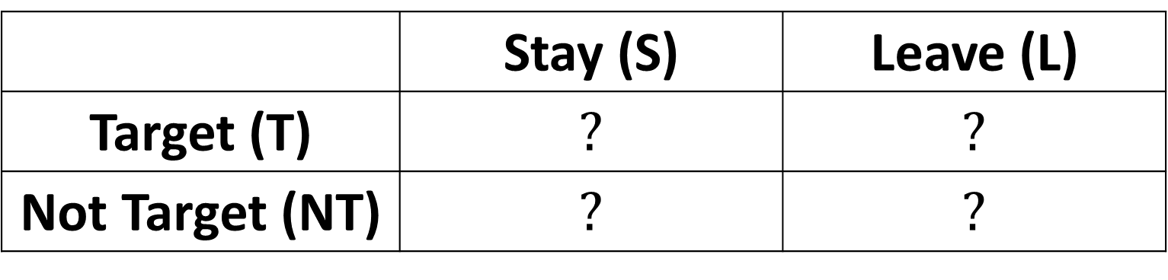
Benefit Matrix
 | Stay (S) | Leave (L)
Target (T) | $$?$$ | $$?$$
Not Target (NT) | $$?$$ | $$?$$

Slide 9
We should target if doing so is profitable.
$$EV_{T}>EV_{NT}$$

Slide 10
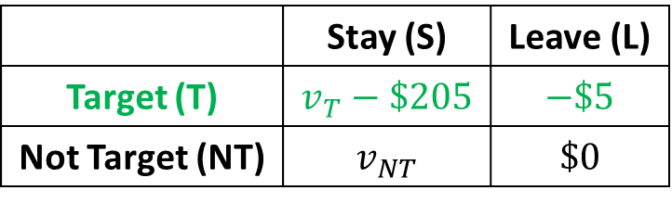
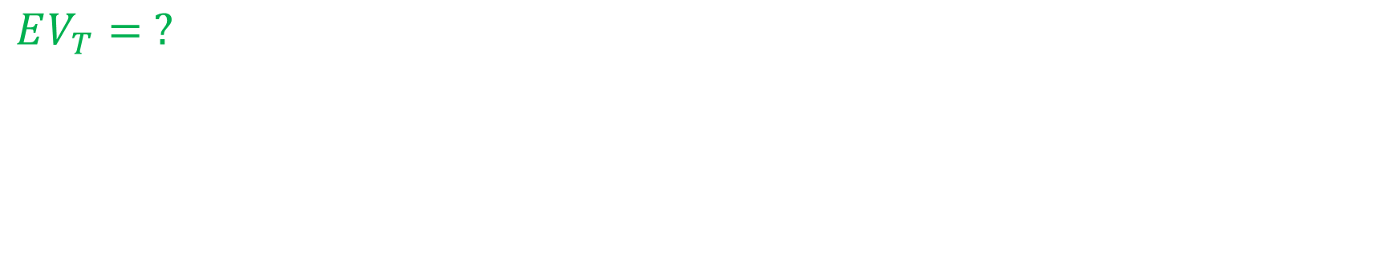
We should target if doing so is profitable.
$$EV_{T}>EV_{NT}$$
 | Stay (S) | Leave (L)
Target (T) | $$v_{T}−\$205$$ | $$−\$5$$
Not Target (NT) | $$v_{NT}$$ | $$\$0$$
$$EV_{T}= ?$$

Slide 11
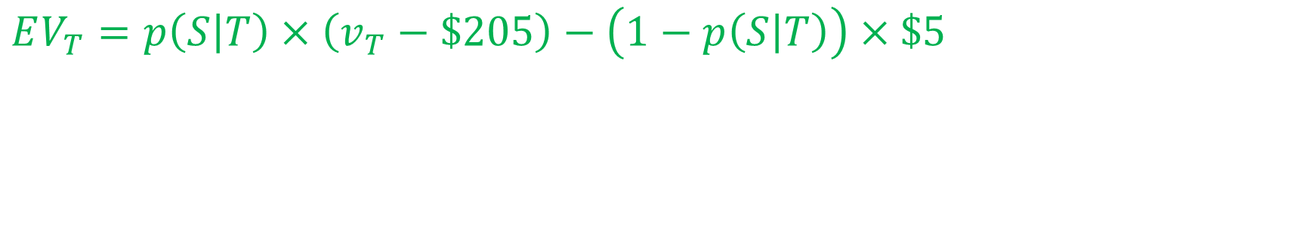
We should target if doing so is profitable.
$$EV_{T}>EV_{NT}$$
 | Stay (S) | Leave (L)
Target (T) | $$v_{T}−\$205$$ | $$−\$5$$
Not Target (NT) | $$v_{NT}$$ | $$\$0$$
$$EV_{T}=p\left(S | T\right)×\left(v_{T}−\$205\right)−\left(1−p\left(S | T\right)\right)×\$5$$

Slide 12
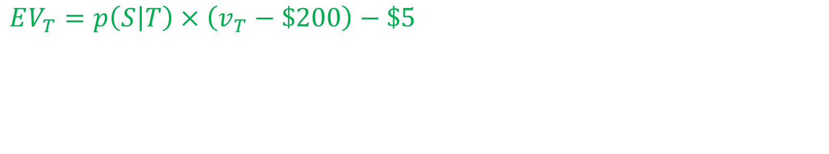
We should target if doing so is profitable.
$$EV_{T}>EV_{NT}$$
 | Stay (S) | Leave (L)
Target (T) | $$v_{T}−\$205$$ | $$−\$5$$
Not Target (NT) | $$v_{NT}$$ | $$\$0$$
$$EV_{T}=p\left(S | T\right)×\left(v_{T}−\$200\right)−\$5$$

Slide 13
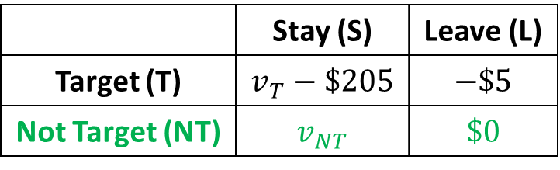
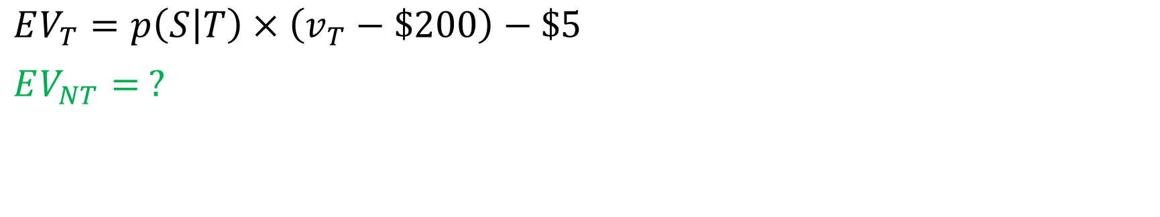
We should target if doing so is profitable.
$$EV_{T}>EV_{NT}$$
 | Stay (S) | Leave (L)
Target (T) | $$v_{T}−\$205$$ | $$−\$5$$
Not Target (NT) | $$v_{NT}$$ | $$\$0$$
$$EV_{T}=p\left(S | T\right)×\left(v_{T}−\$200\right)−\$5$$
$$EV_{NT}= ?$$

Slide 14
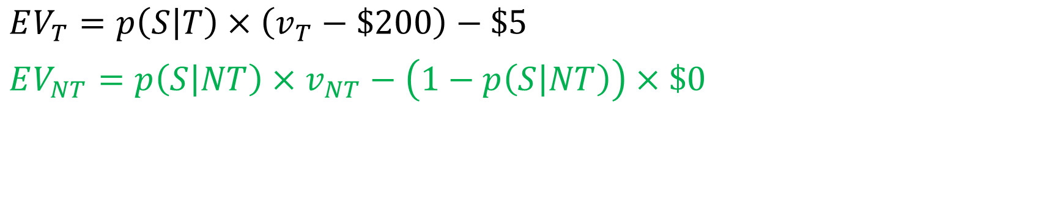
We should target if doing so is profitable.
$$EV_{T}>EV_{NT}$$
 | Stay (S) | Leave (L)
Target (T) | $$v_{T}−\$205$$ | $$−\$5$$
Not Target (NT) | $$v_{NT}$$ | $$\$0$$
$$EV_{T}=p\left(S | T\right)×\left(v_{T}−\$200\right)−\$5$$
$$EV_{NT}=p\left(S | NT\right)×v_{NT}−\left(1−p\left(S | NT\right)\right)×\$0$$

Slide 15
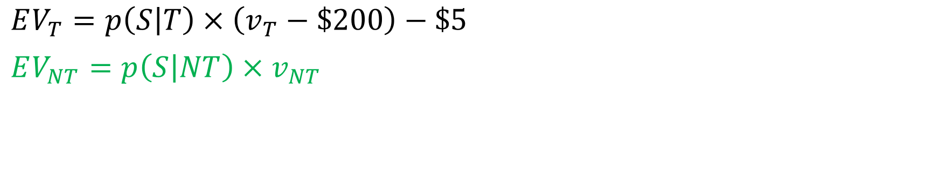
We should target if doing so is profitable.
$$EV_{T}>EV_{NT}$$
 | Stay (S) | Leave (L)
Target (T) | $$v_{T}−\$205$$ | $$−\$5$$
Not Target (NT) | $$v_{NT}$$ | $$\$0$$
$$EV_{T}=p\left(S | T\right)×\left(v_{T}−\$200\right)−\$5$$
$$EV_{NT}=p\left(S | NT\right)×v_{NT}$$

Slide 16
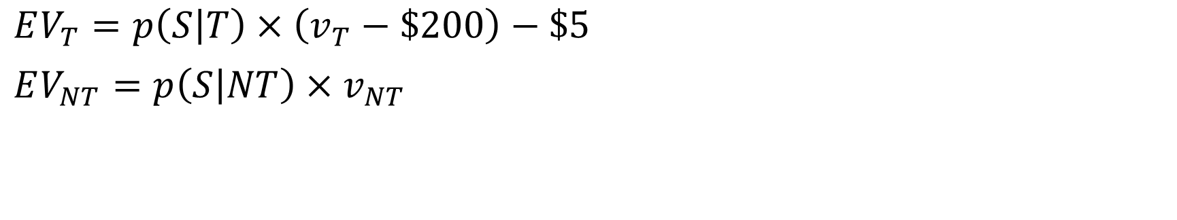
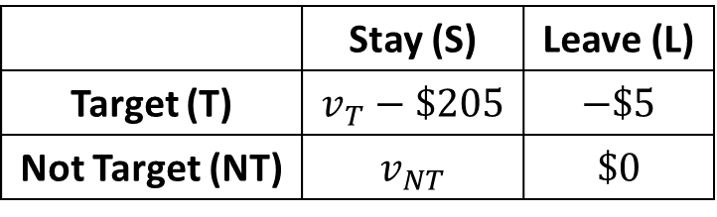
We should target if doing so is profitable.
$$EV_{T}>EV_{NT}$$
 | Stay (S) | Leave (L)
Target (T) | $$v_{T}−\$205$$ | $$−\$5$$
Not Target (NT) | $$v_{NT}$$ | $$\$0$$
$$EV_{T}=p\left(S | T\right)×\left(v_{T}−\$200\right)−\$5$$
$$EV_{NT}=p\left(S | NT\right)×v_{NT}$$
Questions?

Slide 17
We should target if doing so is profitable.
$$p\left(S | T\right)×\left(v_{T}−\$200\right)−\$5>p\left(S | NT\right)×v_{NT}$$

Slide 18
We should target if doing so is profitable.
$$p\left(S | T\right)×v_{T}−p\left(S | NT\right)×v_{NT}>p\left(S | T\right)×\$200+\$5$$
Benefit
Cost

Slide 19
$$p\left(S | T\right)×v_{T}−p\left(S | NT\right)×v_{NT}>p\left(S | T\right)×\$200+\$5$$
Is there data to calculate or estimate this quantity?

Slide 20
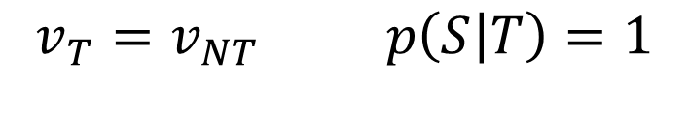
In the absence of adequate data… …we could make some assumptions.
If:
$$v_{T}=v_{NT} p\left(S | T\right)=1$$
Then:
$$p\left(S | T\right)×v_{T}−p\left(S | NT\right)×v_{NT}>p\left(S | T\right)×\$200+\$5$$
Becomes:
$$p\left(Leave | NT\right)×v_{NT}>\$205$$
Questions?

Slide 21




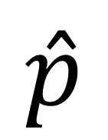

Key Takeaway Our decision logic can incorporate multiple quantities (possibly from multiple models).
$$\hat{v}$$
Regression Model
Estimated Value
$$\hat{p}$$
Action
Data Instance
Estimated Probability
Decision Logic
Probability Model

Slide 22
What other alternatives, besides making assumptions, do we have?

Slide 23
What key factors should we consider when retrieving data from previous marketing campaigns?

Slide 24
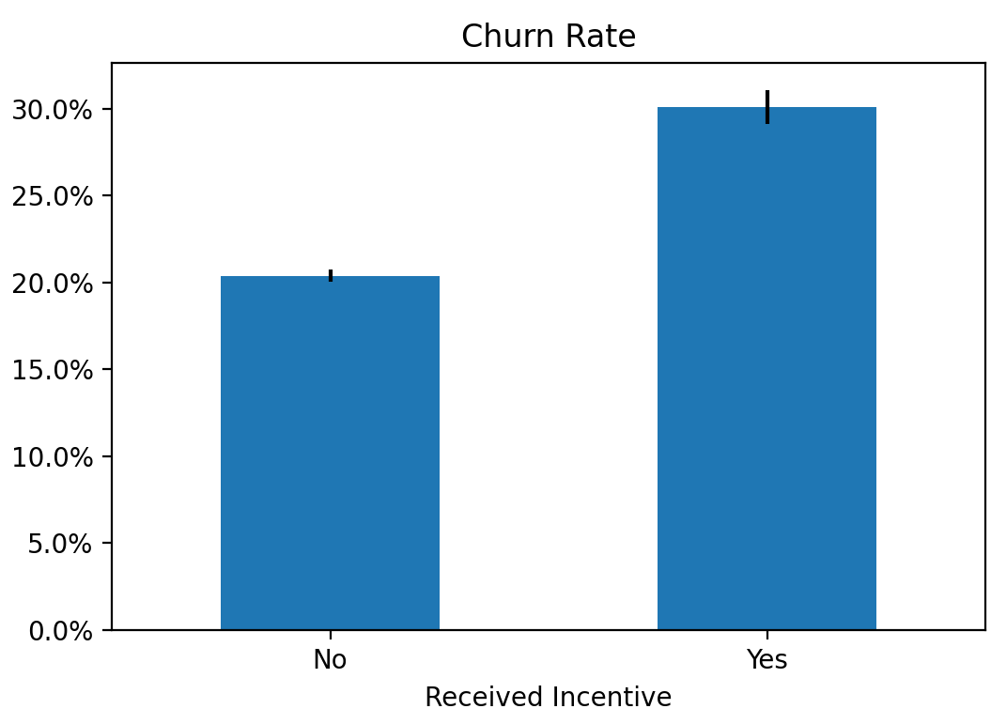
How should we interpret this chart from a past campaign?
Churn %

Slide 25
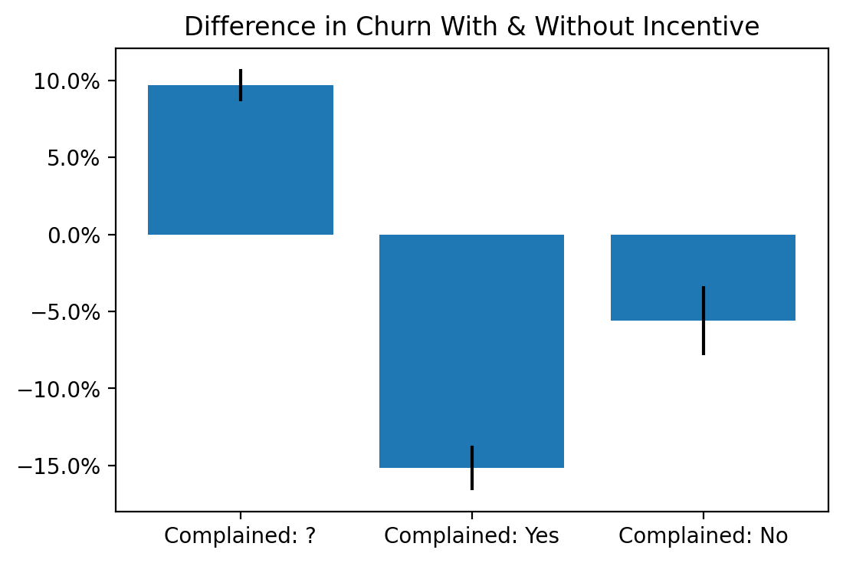
Let’s zoom in. How is this result possible?
Churn % with Incentive $−$ Churn % without Incentive

Slide 26
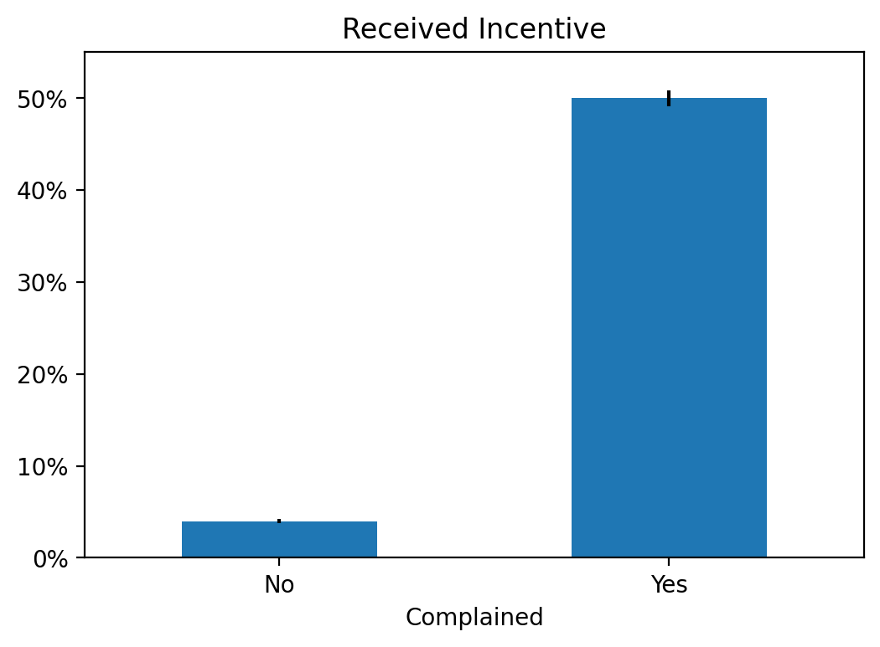
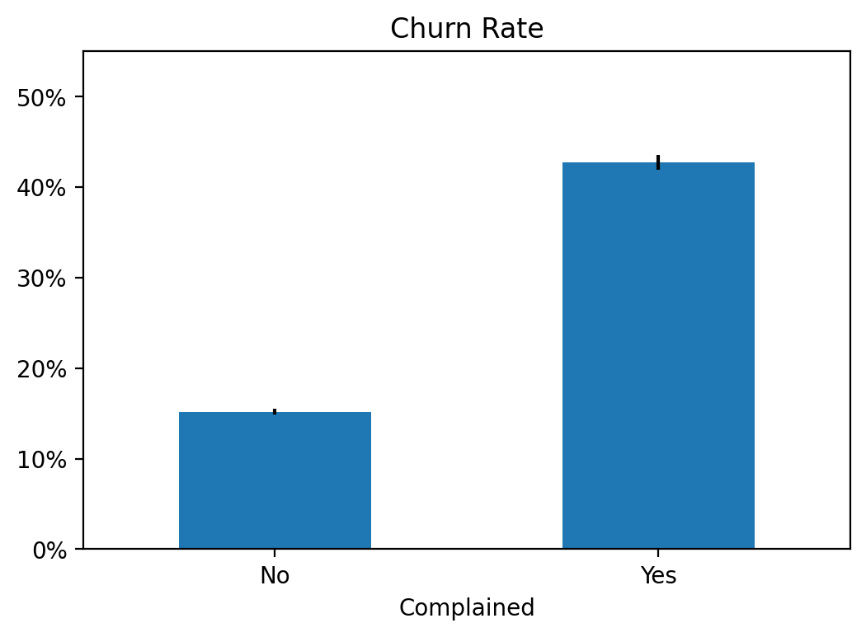
% Receiving Incentive
Churn %
Probability of Churn

Slide 27
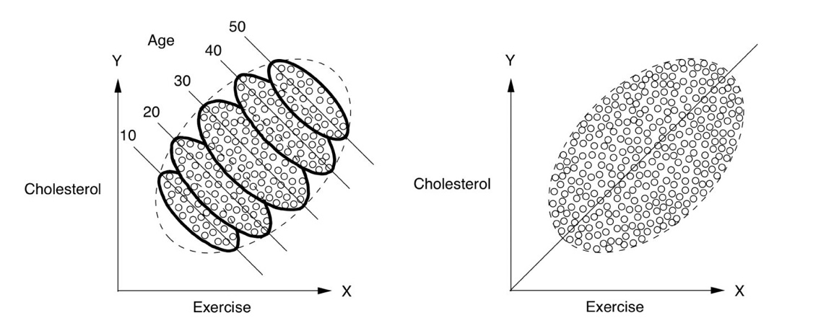
Simpson’s Paradox

Slide 28
To infer causation from correlation, we need an apples-to-apples comparison.

Slide 29

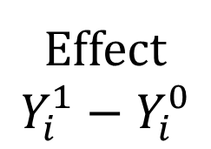
Effect
$${Y_{i}^{1}−Y}_{i}^{0}$$
T
NT
A causal effect is the difference between two potential outcomes (alternative realities).

Slide 30
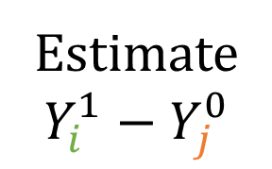
Effect
$${Y_{i}^{1}−Y}_{i}^{0}$$
Estimate
$${Y_{i}^{1}−Y}_{j}^{0}$$
But we only observe
one potential outcome for each person.
To estimate effects, we compare individuals exposed to different conditions.
T
NT
T
NT
Key Assumptions:
Experimentation: 1s & 0s

Slide 31
Effect
$${Y_{i}^{1}−Y}_{i}^{0}$$
Estimate
$${Y_{i}^{1}−Y}_{j}^{0}$$
T
NT
T
NT
Key Assumptions:
Experimentation: 1s & 0s
Any concern?

Slide 32
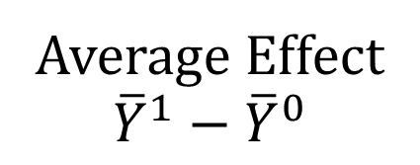
Effect
$${Y_{i}^{1}−Y}_{i}^{0}$$
Estimate
$${Y_{i}^{1}−Y}_{j}^{0}$$
Average Effect
$${\overline{Y}}^{1}−{\overline{Y}}^{0}$$
T
NT
T
NT
T
NT
Key Assumptions:
Experimentation: 1s & 0s
This is where Statistics comes in.

Slide 33
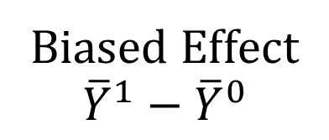
Effect
$${Y_{i}^{1}−Y}_{i}^{0}$$
Estimate
$${Y_{i}^{1}−Y}_{j}^{0}$$
Average Effect
$${\overline{Y}}^{1}−{\overline{Y}}^{0}$$
Biased Effect
$${\overline{Y}}^{1}−{\overline{Y}}^{0}$$
T
NT
T
NT
T
NT
T
NT
Key Assumptions:
Experimentation: 1s & 0s
No confounding: Comparable groups
But we must be careful!

Slide 34
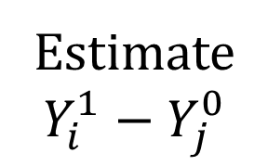
Effect
$${Y_{i}^{1}−Y}_{i}^{0}$$
Estimate
$${Y_{i}^{1}−Y}_{j}^{0}$$
Average Effect
$${\overline{Y}}^{1}−{\overline{Y}}^{0}$$
Biased Effect
$${\overline{Y}}^{1}−{\overline{Y}}^{0}$$
T
NT
T
NT
T
NT
T
NT
Key Assumptions:
Experimentation: 1s & 0s
No confounding: Comparable groups
No contamination: Each treatment affects one individual.
Super careful!
Questions?

Slide 35
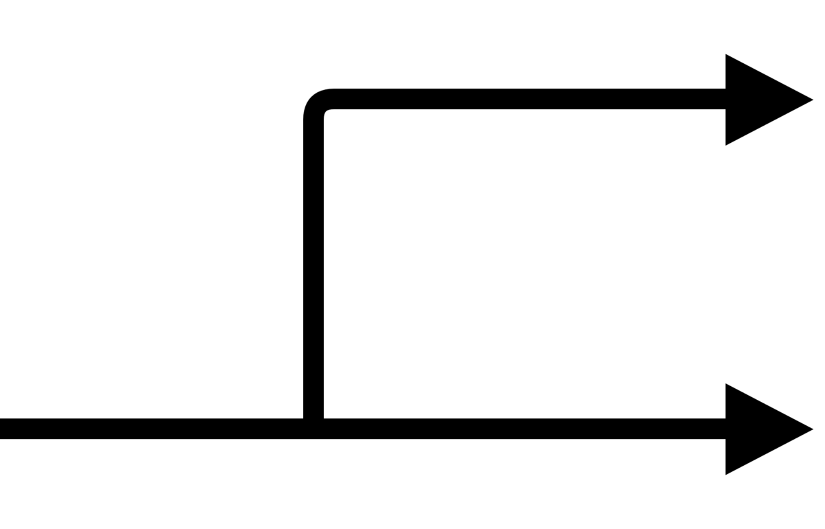
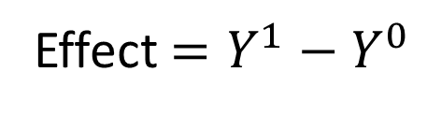


Key Takeaway A causal effect is the difference between two potential outcomes.
Incentive
$$Y^{1}$$
Effect $=Y^{1}−Y^{0}$
$$Y^{0}$$
NO Incentive
Customer

Slide 36


Key Takeaway We can’t observe both potential outcomes. So: We estimate effects by comparing people exposed to different conditions.
Do NOT Give Incentive
Give Incentive

Slide 37


Key Takeaway Beware of treatments that could affect multiple people.
No reminder
Spending drops.
Spending increases.
Reminder

Slide 38
Key Takeaway Beware of treatments that could affect multiple people.
Spending at the auction level with no reminder.
Fix:
vs.
Spending at the auction level with reminder.

Slide 39


Key Takeaway To infer causality, we must make apples-to-apples comparisons.
Churn rate with incentive
Churn rate without incentive
Incentive Effect
Churn rate with incentive
Churn rate without incentive
Incentive Effect

Slide 40
How can we make apples-to-apples comparison?

Slide 41
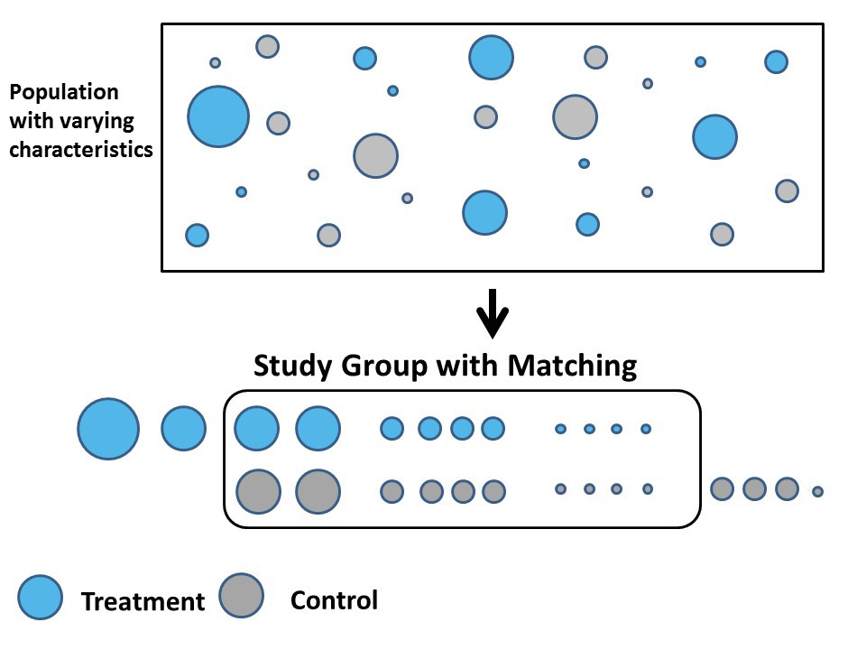

Slide 42

But how do we match these?
Control
Treatment

Slide 43
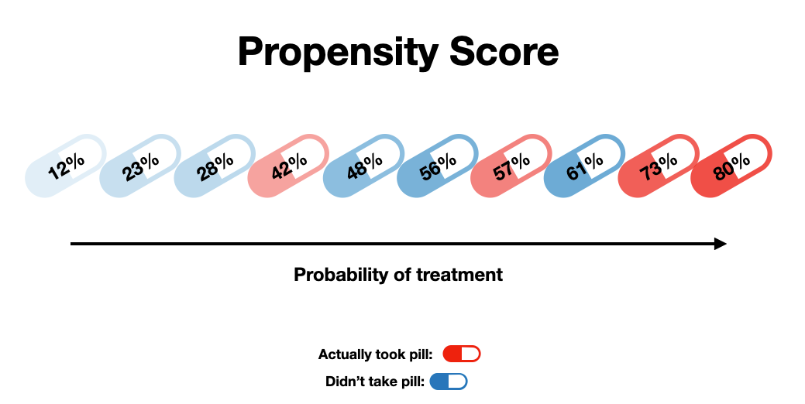
Estimate with machine learning!

Slide 44
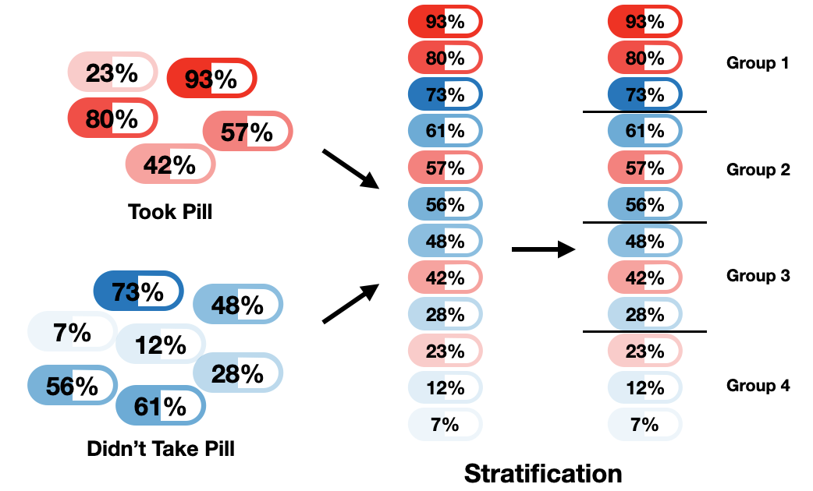

Slide 45
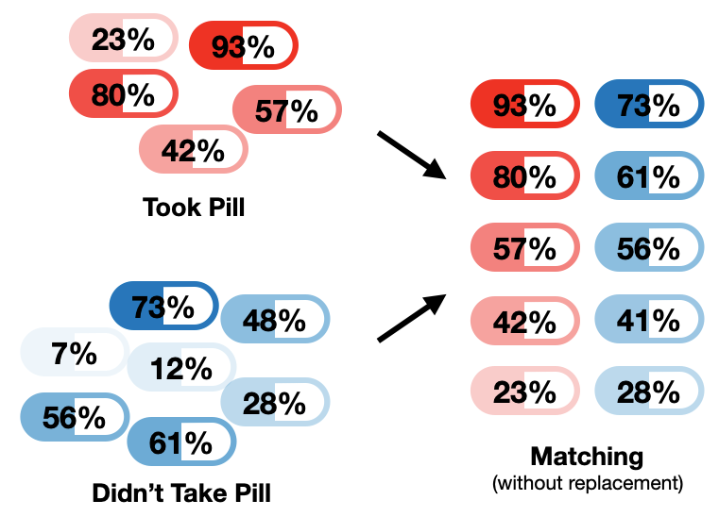

Slide 46

Same
observation.
(with replacement)

Slide 47
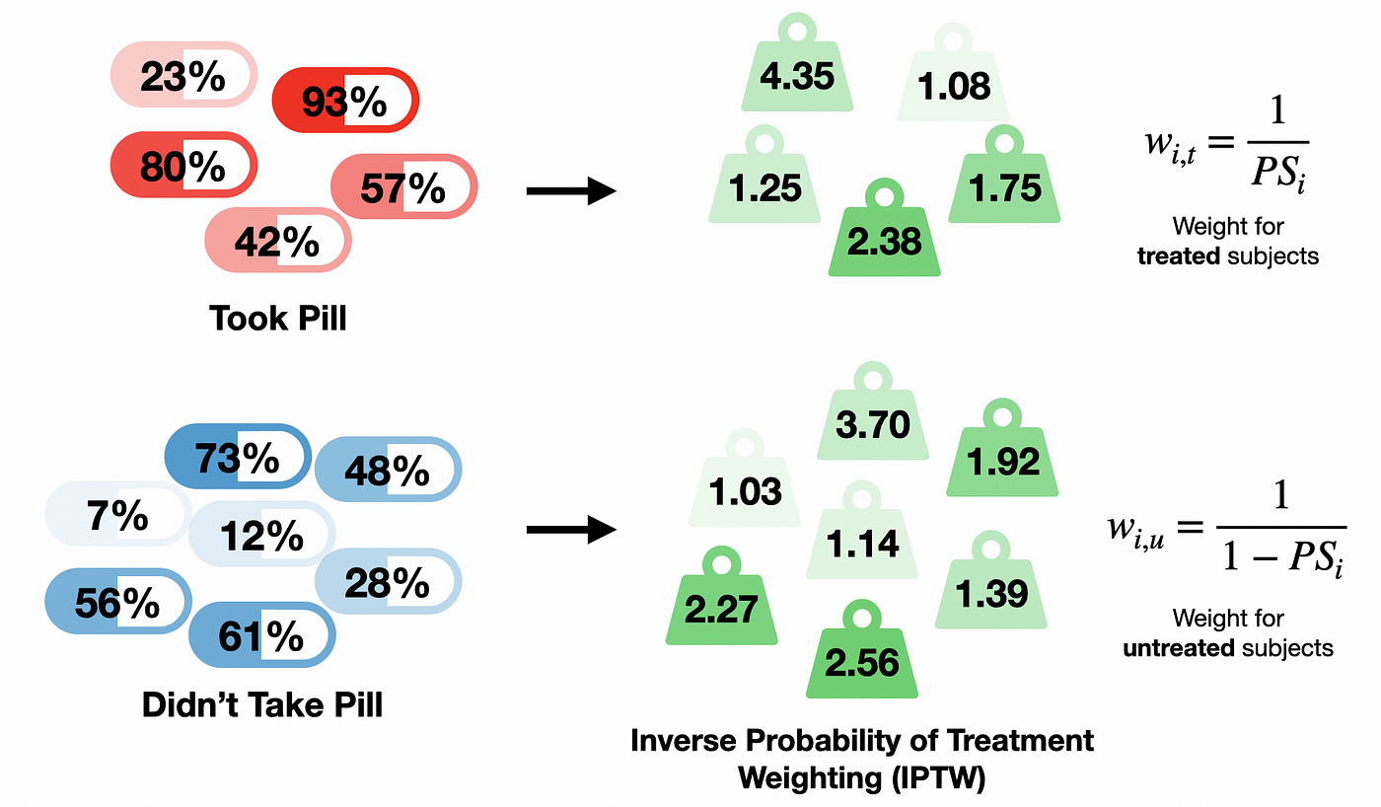

Slide 48
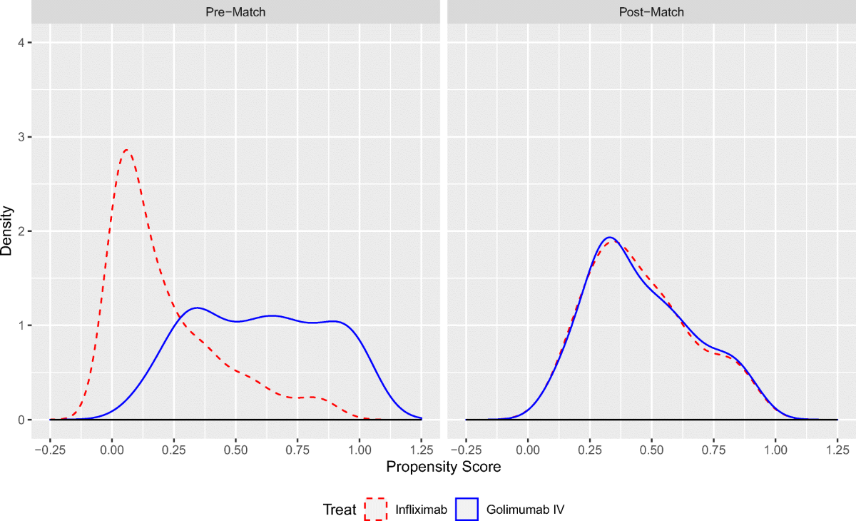
Questions?
Control
Treatment

Slide 49


Incentive
No Incentive
Churn 30%
Churn 20%

Slide 50
Incentive
NO Incentive
Concerns?
Complained
Churn 35%
Churn 50%
No Complaints
Churn 10%
Churn 15%

Slide 51




Incentive
NO Incentive
High Spending
Low Spending
Complained
Churn 35%
Churn 50%
No Complaints
Churn 10%
Churn 15%

Slide 52
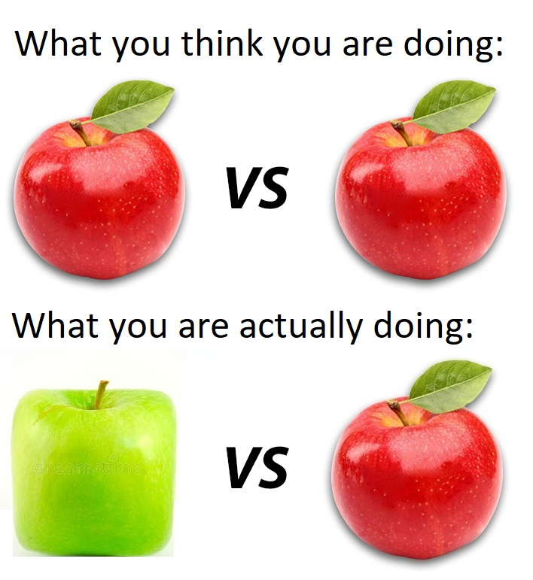
Key Takeaway We can’t be certain that groups are comparable by just looking at the data.
What you may actually be doing:

Slide 53

Our options are:
Let’s explore this.
Make assumptions.
Collect better data.

Slide 54
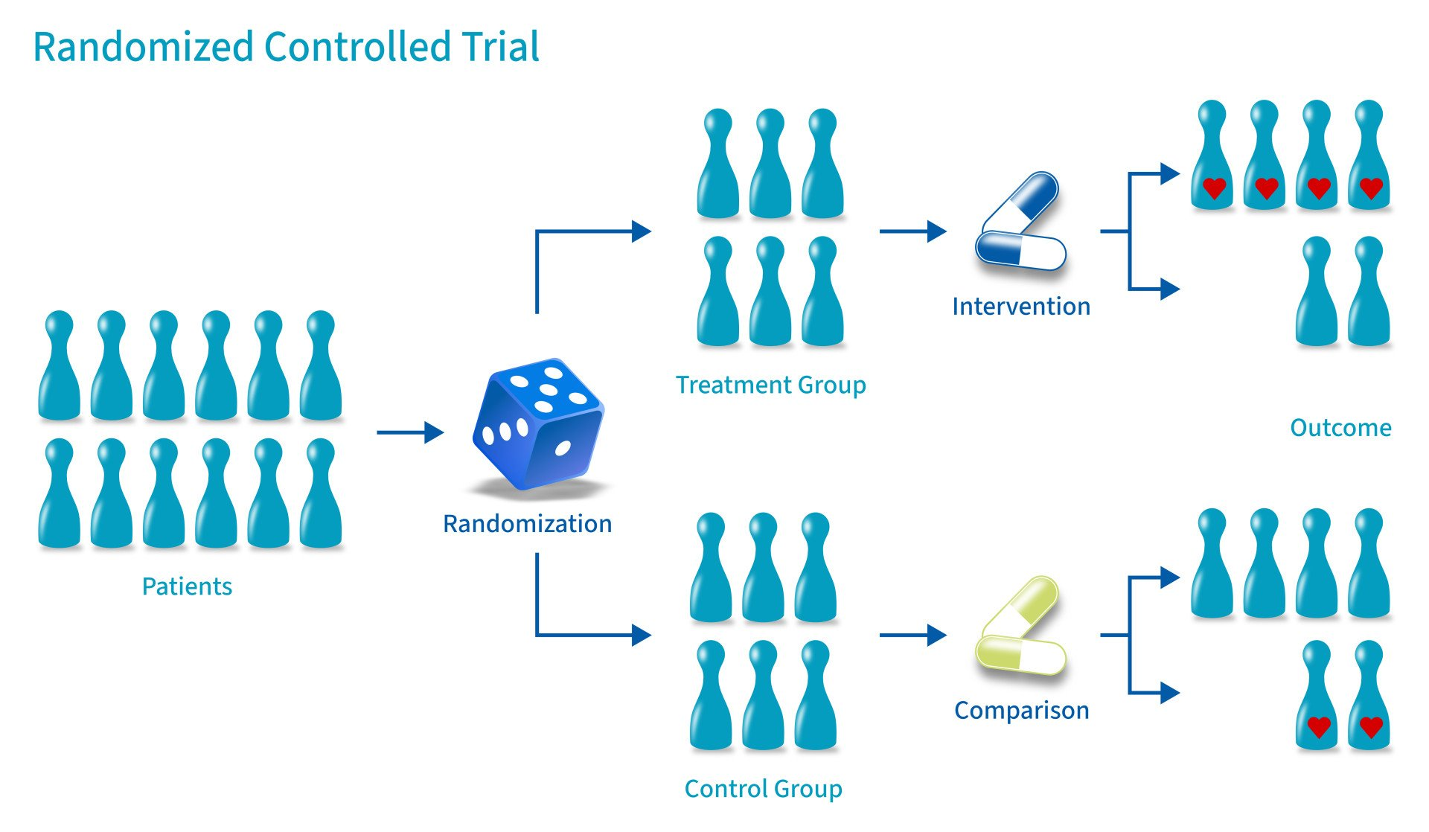
(known as A/B testing in digital world)
Incentive
Retention
Contracts
No Incentive

Slide 55
(known as A/B testing in digital world)
If concerned about
effectiveness…
5%
Incentive
Retention
Contracts
95%
No Incentive

Slide 56
(known as A/B testing in digital world)
95%
Incentive
Retention
Contracts
If concerned about
opportunity cost…
5%
No Incentive

Slide 57
(known as A/B testing in digital world)
95%
Incentive
Retention
Contracts with a large
enough potential loss
5%
No Incentive
Remember to choose appropriate population!

Slide 58
Questions?
(known as A/B testing in digital world)
95%
Incentive
Retention
Contracts with a large
enough potential loss
5%
No Incentive

Slide 59
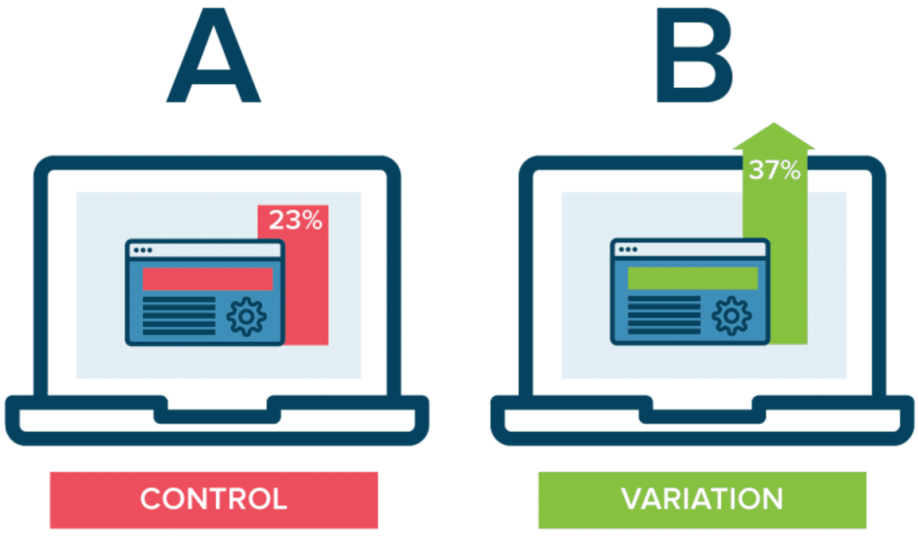


Is the treatment effective in general?
CONTROL
TREATMENT
A/B Testing
On whom is the treatment most effective?
Good data!
Machine Learning

Slide 60

$Effect=Y_{T}−Y_{U}$
Incentive
NO Incentive
$Y_{T}$ and $Y_{U}$ are the potential outcomes if treated and untreated.
Notes:
Causal Effect Estimation for Decision Making
Estimation of the difference between two potential outcomes. Introduce Rubin model.
Machine learning can be used to predict each potential outcome.
This allows to estimate effects at the individual level.

Slide 61

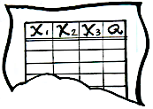

$$\hat{Effect}={\hat{Y}}_{T}\left(X\right)$$
Machine Learning Algorithm
Model for the treated outcome
X₁
X₂
Y_{T}
Y_{U}
7
Red
Yes
?
X₁
X₂
Y_{T}
Y_{U}
12
Blue
No
?
3
Blue
?
?
6
Blue
Yes
?
No
?
Data Instance
Labeled Data
(Treatment)
Notes:
Causal Effect Estimation for Decision Making
Estimation of the difference between two potential outcomes. Introduce Rubin model.
Machine learning can be used to predict each potential outcome.
This allows to estimate effects at the individual level.

Slide 62

Questions?
$$\hat{Effect}={\hat{Y}}_{T}\left(X\right)−{\hat{Y}}_{U}(X)$$
Machine Learning Algorithm
Machine Learning Algorithm
Model for the treated outcome
Model for the untreated outcome
Y_{T}
Y_{U}
X₁
X₂
Y_{T}
Y_{U}
X₁
X₂
No
7
Red
Yes
?
X₁
X₂
Y_{T}
Y_{U}
15
Green
?
Blue
No
?
9
Blue
?
No
12
3
Blue
?
?
5
Red
?
Yes
6
Blue
Yes
?
?
Yes
No
?
Data Instance
Labeled Data
(Control)
Labeled Data
(Treatment)
Notes:
Causal Effect Estimation for Decision Making
Estimation of the difference between two potential outcomes. Introduce Rubin model.
Machine learning can be used to predict each potential outcome.
This allows to estimate effects at the individual level.

Slide 63
Beware of confounding!
$$\hat{Effect}={\hat{Y}}_{T}\left(X\right)−{\hat{Y}}_{U}(X)$$
Machine Learning Algorithm
Machine Learning Algorithm
Model for the treated outcome
Model for the untreated outcome
Y_{T}
Y_{U}
X₁
X₂
Y_{T}
Y_{U}
X₁
X₂
No
7
Red
Yes
?
X₁
X₂
Y_{T}
Y_{U}
15
Green
?
Blue
No
?
9
Blue
?
No
12
3
Blue
?
?
5
Red
?
Yes
6
Blue
Yes
?
?
Yes
No
?
Data Instance
Labeled Data
(Control)
Labeled Data
(Treatment)
Notes:
Causal Effect Estimation for Decision Making
Estimation of the difference between two potential outcomes. Introduce Rubin model.
Machine learning can be used to predict each potential outcome.
This allows to estimate effects at the individual level.

Slide 64
That’s why we use data from an A/B test
$$\hat{Effect}={\hat{Y}}_{T}\left(X\right)−{\hat{Y}}_{U}(X)$$
Machine Learning Algorithm
Machine Learning Algorithm
Model for the treated outcome
Model for the untreated outcome
Y_{T}
Y_{U}
X₁
X₂
Y_{T}
Y_{U}
X₁
X₂
No
7
Red
Yes
?
X₁
X₂
Y_{T}
Y_{U}
15
Green
?
Blue
No
?
9
Blue
?
No
12
3
Blue
?
?
5
Red
?
Yes
6
Blue
Yes
?
?
Yes
No
?
Data Instance
Labeled Data
(Control)
Labeled Data
(Treatment)
Notes:
Causal Effect Estimation for Decision Making
Estimation of the difference between two potential outcomes. Introduce Rubin model.
Machine learning can be used to predict each potential outcome.
This allows to estimate effects at the individual level.

Slide 65
Questions?
$$\hat{Effect}={\hat{Y}}_{T}\left(X\right)−{\hat{Y}}_{U}(X)$$
Machine Learning Algorithm
Machine Learning Algorithm
Model for the treated outcome
Model for the untreated outcome
Y_{T}
Y_{U}
X₁
X₂
Y_{T}
Y_{U}
X₁
X₂
No
7
Red
Yes
?
X₁
X₂
Y_{T}
Y_{U}
15
Green
?
Blue
No
?
9
Blue
?
No
12
3
Blue
?
?
5
Red
?
Yes
6
Blue
Yes
?
?
Yes
No
?
Data Instance
Labeled Data
(Control)
Labeled Data
Labeled Data
(Treatment)
Notes:
Causal Effect Estimation for Decision Making
Estimation of the difference between two potential outcomes. Introduce Rubin model.
Machine learning can be used to predict each potential outcome.
This allows to estimate effects at the individual level.

Slide 66
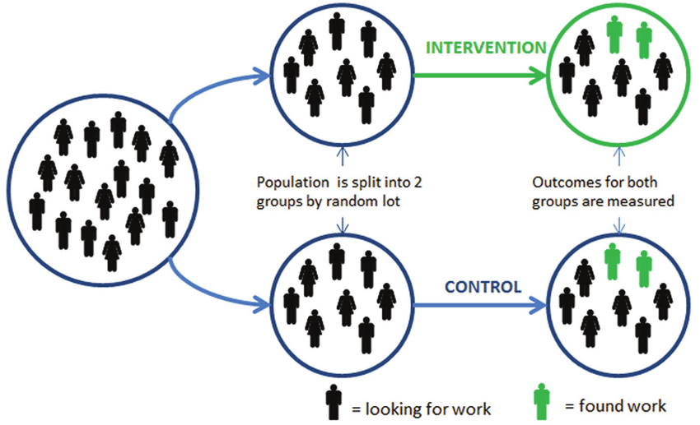
Key Takeaway We can use A/B testing to collect data on comparable groups.

Slide 67

Key Takeaway We can use Machine Learning + A/B Test data to predict how effects vary.
$$\hat{Effect}={\hat{Y}}_{T}\left(X\right)−{\hat{Y}}_{U}(X)$$
Machine Learning Algorithm
Machine Learning Algorithm
Model for the treated outcome
Model for the untreated outcome
Y_{T}
Y_{U}
X₁
X₂
Y_{T}
Y_{U}
X₁
X₂
No
7
Red
Yes
?
X₁
X₂
Y_{T}
Y_{U}
15
Green
?
Blue
No
?
9
Blue
?
No
12
3
Blue
?
?
5
Red
?
Yes
6
Blue
Yes
?
?
Yes
No
?
Data Instance
Labeled Data
(Control)
Labeled Data
(Treatment)

Slide 68
Evaluating A Decision Rule with A/B Test Data

Slide 69
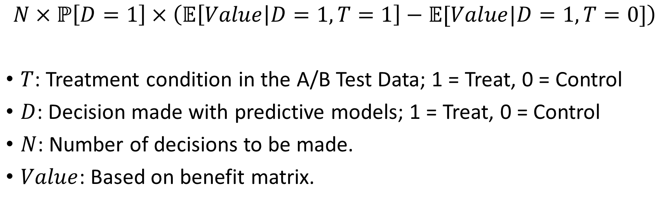
Effect of Decision Rule
$$N×ℙ\left[D=1\right]×\left(𝔼\left[Value | D=1,T=1\right]−𝔼[Value|D=1,T=0]\right)$$
$T$: Treatment condition in the A/B Test Data; 1 = Treat, 0 = Control
$D$: Decision made with predictive models; 1 = Treat, 0 = Control
$N$: Number of decisions to be made.
$Value$: Based on benefit matrix.

Slide 70
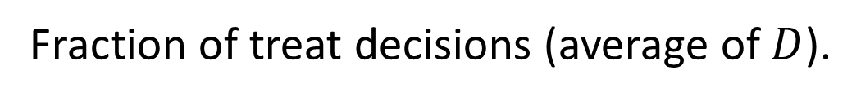
Effect of Decision Rule
$$N×ℙ\left[D=1\right]×\left(𝔼\left[Value | D=1,T=1\right]−𝔼[Value|D=1,T=0]\right)$$
Average value when not treated (estimate from cases
where treatment is decided but not applied).
Average value when treated (estimate from cases
where treatment is decided and applied).
Fraction of treat decisions (average of $D$).

Slide 71
Key Takeaway We can also use A/B test data to evaluate causal decisions.
$$N×ℙ\left[D=1\right]×\left(𝔼\left[Value | D=1,T=1\right]−𝔼[Value|D=1,T=0]\right)$$
Fraction treated by
the decision rule.
Average effect for those treated
by the decision rule.

Slide 72
The Plan
Week 1: Problem formulation.
Week 2: Modeling (Part 1).
Week 3: Modeling (Part 2).
Week 4: Model Evaluation.
Week 5: Causal analytics.
Week 6: Big (unstructured) data.
Week 7: Generative AI (e.g., ChatGPT).
Week 8: Final Exam.
Fundamentals
(What I think are) The Big Three

Slide 73
Key Takeaway Our decision logic can incorporate multiple quantities (possibly from multiple models).
$$\hat{v}$$
Regression Model
Estimated Value
$$\hat{p}$$
Action
Data Instance
Estimated Probability
Decision Logic
Probability Model

Slide 74
Key Takeaway A causal effect is the difference between two potential outcomes.
Incentive
$$Y^{1}$$
Effect $=Y^{1}−Y^{0}$
$$Y^{0}$$
NO Incentive
Customer

Slide 75
Key Takeaway We can’t observe both potential outcomes. So: We estimate effects by comparing people exposed to different conditions.
Do NOT Give Incentive
Give Incentive

Slide 76
Key Takeaway Beware of treatments that could affect multiple people.
No reminder
Reminder

Slide 77
Key Takeaway To infer causality, we must make apples-to-apples comparisons.
Churn rate with incentive
Churn rate without incentive
Incentive Effect
Churn rate with incentive
Churn rate without incentive
Incentive Effect

Slide 78
Key Takeaway We can’t be certain that groups are comparable by just looking at the data.
What you may actually be doing:

Slide 79
Key Takeaway We can use A/B testing to collect data on comparable groups.

Slide 80
Key Takeaway We can use Machine Learning + A/B Test data to predict how effects vary.
$$\hat{Effect}={\hat{Y}}_{T}\left(X\right)−{\hat{Y}}_{U}(X)$$
Machine Learning Algorithm
Machine Learning Algorithm
Model for the treated outcome
Model for the untreated outcome
Y_{T}
Y_{U}
X₁
X₂
Y_{T}
Y_{U}
X₁
X₂
No
7
Red
Yes
?
X₁
X₂
Y_{T}
Y_{U}
15
Green
?
Blue
No
?
9
Blue
?
No
12
3
Blue
?
?
5
Red
?
Yes
6
Blue
Yes
?
?
Yes
No
?
Data Instance
Labeled Data
(Control)
Labeled Data
(Treatment)

Slide 81
Key Takeaway We can also use A/B test data to evaluate causal decisions.
$$N×ℙ\left[D=1\right]×\left(𝔼\left[Value | D=1,T=1\right]−𝔼[Value|D=1,T=0]\right)$$
Fraction treated by
the decision rule.
Average effect for those treated
by the decision rule.

